Slide 1
Proposal : Genus –Enhanced Security variant

Slide 2
Background
As a platform Genus is excellent device for more secure (locked) variant of commercial phone
  Critical HW interfaces protected in secure PWB
  Genus device implements secure boot & secure flashing of device
There are several SW features which can be turned on to enhance device security
With enhanced (locked) device security it’s possible to found new customer segments for device sales
  Authorities
  Government agencies
  Emergency response personnel
  Energy and utility companies
Copyright Elektrobit Corporation 2010, Elektrobit.com
Confidential, November 7, 2026, Slide <number>

Slide 3
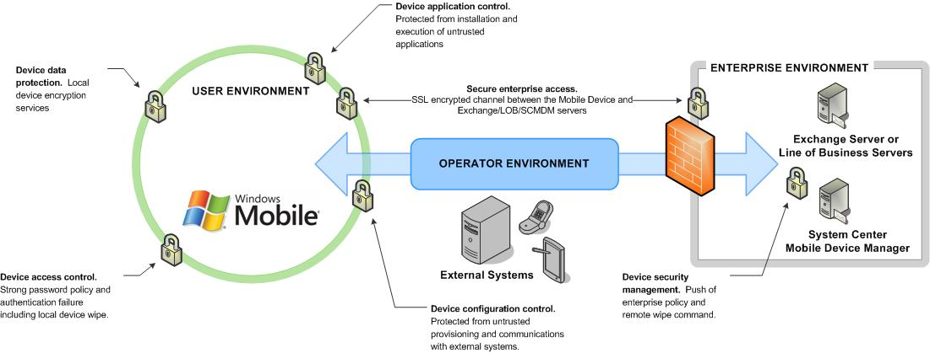
Security - operational features
Windows mobile devices contains several features which are used to control device security: Device access control, Device data protection, Secure enterprise access, Device application control, Device security management and Device configuration control (OMA Device Management 1.2)
Each of these features can be modified as needed by end customer

Slide 4
Security features – more details
Device data protection. The Mobile Device provides the capability to protect data at rest and in transit.
Device application control. The Mobile Device provides the capability to only permit trusted applications to be installed and executed on the Mobile Device.
Secure enterprise access. The Mobile Device provides the capability to securely connect the Mobile Device to trusted Enterprise assets and facilitate data transfer.
Device configuration control. The Mobile Device provides the capability to protect against modification by un-trusted systems.
Device access control. The Mobile Device has inbuilt security mechanisms that can be enabled to provide controlled access to the Mobile Device.
Device security management. The Mobile Device has configurable security policies that establish which actions a user or application may take.

Slide 5
Security features - Enhancements
Device data protection
  Encrypting of user data, As default in Genus device data encrypting in Windows Mobile is not turned on
    In enhanced security device all end user data can be protected with 128-bit AES encrypting
      Data encrypting can be used for device internal memory and device storage card
Device application control
  Application installation, As default, Genus device allows unsigned applications to be installed to device
    In enhanced security device Windows Mobile can be configured to only permit applications signed with a trusted certificate to be installed and access privileged resources
      Signing authorities can be controlled by defining which certificates are allowed to be in device. Suspicious certificates can be removed.
      Controlled application execution, code execution control allows the device to be locked so that only applications signed with a trusted certificate or approved by the Mobile User can execute on the device

Slide 6
Security features - Enhancements
Secure enterprise access
  E-mail protecting – A a default Genus device in not signing and encrypting e-mails sent out from device
    In enhanced secure device Windows Mobile can be configured to signing and encrypting
      Signing and encrypting can be separately turned on
  Force VPN use
Device access control
  Device authentication and lock, As a default Genus device is not requiring login password
    In enhanced secure device Windows Mobile can be configured to require always a password to gain access to the Mobile Device, however, it is possible to receive incoming calls and to make emergency calls without authenticating.
  Local device wipe, As a default local wipe is not enabled in Genus device
    In enhanced secure device Windows Mobile can be configured to perform a local device wipe after a specified number of incorrect login attempts.

Slide 7
Security features - Enhancements
Device configuration control
  Device configuration, As default in Genus device there is no restrictions to device configuration control.
    In enhanced security device, device configuration control can be limited or fully denied
      Password policy – As a default Genus devices uses simple passwords, for enhanced secure device the strong password type can be forced to be used. Also automatic device lock and locking time out can be set to required value
      Provisioning - As a default Genus devices allows device Provisioning, in enhanced secure devices provisioning can be disabled
      SI, An SI message is sent to the connected device to notify users of new services, service updates, and provisioning services – As a default Genus devices accepts SI messages from authorized (for example operator) sender, for enhanced secure devices SI messages can be disabled
      SL, An SL message automatically downloads the new service, update, or provisioning file – As a default Genus devices accepts SL messages from authorized (for example operator) sender, for enhanced secure devices SL messages can be disabled

Slide 8
Security features - Enhancements
Device security management
  Security roles and security policies, as A default Genus devices allows changes to device security roles and policies
    In enhanced security devices changes to device security roles and policies can (must) be fully denied
  Remote data wipe
    In enhanced security devices it’s possible to use remote data wipe if device is lost or stolen
  Remote tools disabling

Slide 9
Security features – optional enhancements
Camera – Disable device camera
GPS – Disable GPS
WLAN – Disable WLAN / Allow only encrypted communication
BT – Disable BT, partial BT disable/profiles
Applications – Removal of unnecessary/suspicious applications
Protecting critical drivers (HIVE protection), forces use of default windows drivers (not updated ones)
SIM Locks

Slide 10

Copyright Elektrobit Corporation 2007, Elektrobit.com
Company Confidential, November 7, 2026, Slide <number>
Copyright Elektrobit Corporation 2010, Confidential

